Slide 1

Appendices

Slide 2
Our Numbers
Bayleys is New Zealand’s largest full service real estate agency.
Bayleys Commercial
The Bayleys Group
160
800
sales and leasing agents
sales people
,
,
1 838
1 300
sales and leasing transactions completed
employees
,
,
,
,
$1 581 629 847
8 151
sales and leasing transactions completed
$1.5 billion of commercial property sold or leased
,
,
,
$6 192 524 618
$6 billion of property sold or leased
For the period 1st January 2013 – 31st December 2013

Slide 3
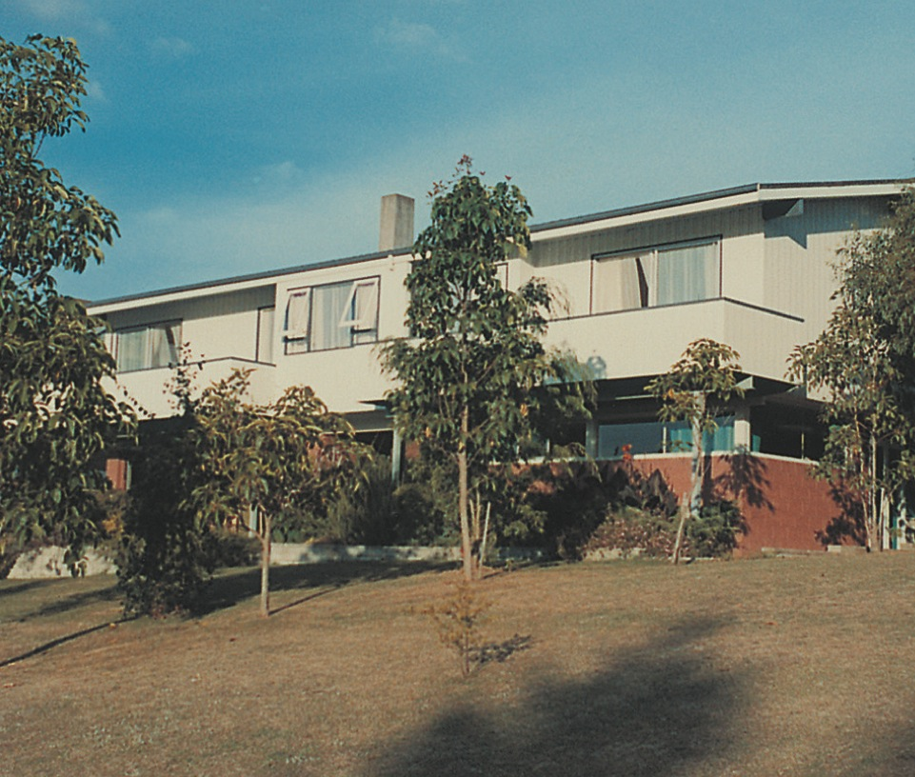
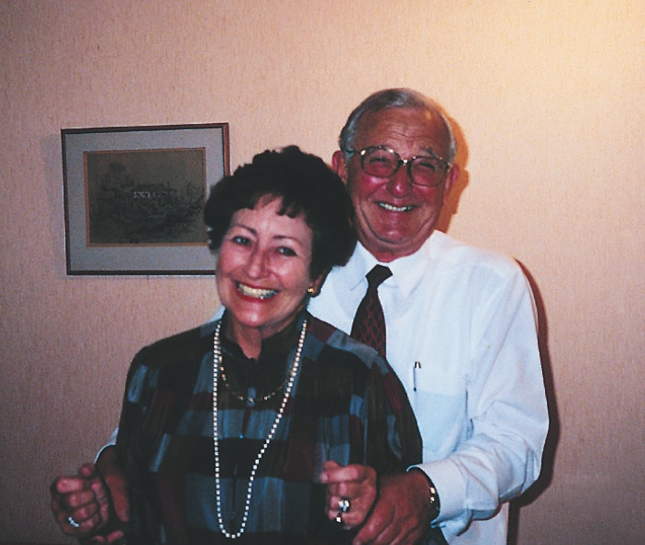
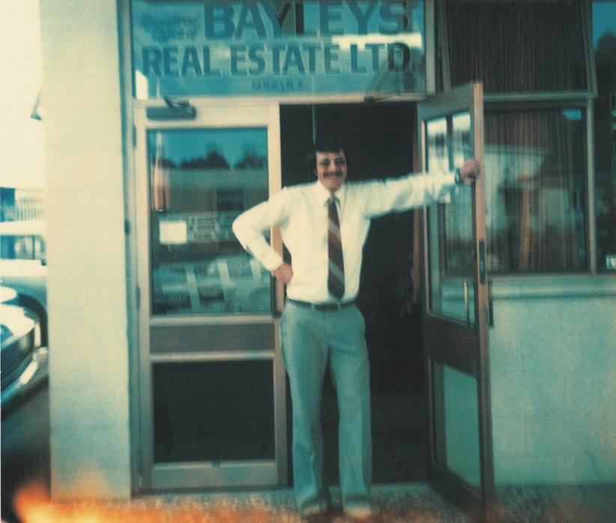

Our Story
Bayleys is a progressive company constantly looking to innovate and do things better.
At our core, we’re also a family business where some things don’t change. In particular, the family values and business principles the company was built on four decades ago. This approach and our commitment to working as an integrated nationwide team is important to our clients and underpins everything we do.
to 64 offices
to 1,300 people
generations...
sectors – giving
us total coverage
In 1973, Graham, Pam and John Bayley started out working from their family home in Pakuranga – Bayleys 1st office. Today we have 64 franchise offices from Kaitaia to Invercargill.
Back then the company consisted of two
full times sales people – the late Graham and son John – supported by Pam, the financial controller, receptionist and administration manager. Today, Bayleys employs a sales force of some 800 sales and leasing agents supported by a 400 strong team of management, administration, marketing, research, public relations and auctioneer professionals.
Almost 40 years on, all of Graham and Pam’s children, and three generations of the Bayley family work for the business. John is Chairman of the Board. David Bayley, who joined the company in the mid-1970s, is principal shareholder with John. David’s son Mike Bayley is Managing Director of Bayley Corporation. Seven grandchildren also work for the company.
We’re proud to be New Zealand’s largest full service real estate company, operating across four sectors nationwide: Commercial, Country, Residential, and Property Related Services including Property Management and Valuations.

Slide 4

Our Story
things that define everything we do
We’re fiercely proud of the family values and beliefs that were the guiding light of Bayleys’ formative years, and still define our operation today.
Client-centric
your best interests underpin everything we do.
Innovate and Evolve
raising the bar to redefine excellence and always
staying ahead of the game.
People Power
respecting and valuing our whole team for
the advantage they offer.
Accountability
responsible for maximising opportunities.
And most importantly, we are completely...
Results Focused
securing the best price, not the first price for our clients.

Slide 5
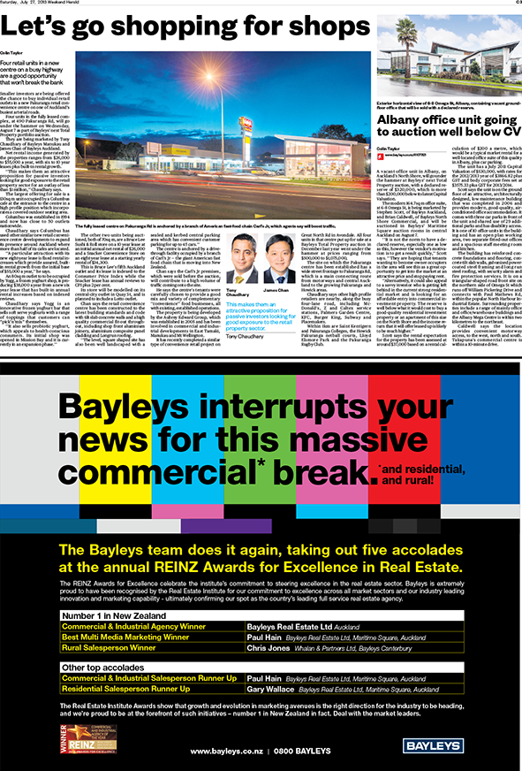


Our Results
An Approach That Works For You Our Customer
Citing values and behaviors is one thing, but having the accolades to back up our claims is what counts.
We are immensely proud to of been awarded New Zealand’s Commercial and Industrial Agency of the Year (for the second year in a row) and Best Multi Media Marketing Campaign at the 2013 Real Estate Institute of New Zealand Awards.
Real Estate Institute of New Zealand Awards
The REINZ Awards for Excellence celebrates the institute’s commitment to steering
excellence in the real estate sector.
Commercial real estate agency
in New Zealand 2013
Commercial real estate agency
in New Zealand 2012
Multi media marketing campaign in
New Zealand 2013

Slide 6
Our Results
Don’t Just Take Our Word For it...
Our clients are at the forefront of everything we do and we measure our success on the feedback they provide us with. We are proud to include some of this feedback for your review.
In the New Zealand context, Bayleys Real Estate is an amazing and sizeable untold commercial success story, up there with the Warehouse and Michael Hill, yet totally unacknowledged for this. I can only imagine this is because they are not a public company, so the news media, and therefore the public remain oblivious to their accomplishment and relevance.
Sir Robert Jones - Robt. Jones Holdings Ltd
Bayleys have the ability to drive the sales process rather than sit and wait for things to happen.
Gary McLean, Head of Corporate Business – Westpac New Zealand
…acted with professionalism, discretion and determination which I have come to expect from Bayleys.
D Niccol, Director – Fletcher Building Nominee Ltd
Their market knowledge and expertise combined with professional marketing has resulted in
excellent results.
Mark B. Weipers, Managing Director – Location Group.

Slide 7
The Power of Marketing
Our Approach to Marketing
Expert marketing has always been a key driver of the results we deliver our vendors. Our ability to bring the right property to the attention of the right buyers is unmatched. We pioneered a number commercial property marketing methodologies that are seen as best practice in the market today.
01
Wide reaching
Our marketing team uses a suite of tools to target the market, employing specialists in digital, direct marketing, branding and sponsorship. We use this marketing power to match the ‘right’ buyer with your property and will leave no stone unturned to do so...
02
Relevant
03
Innovative
04
Market Leading
05
Results Focused

Slide 8
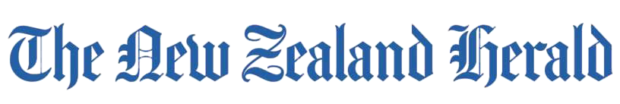

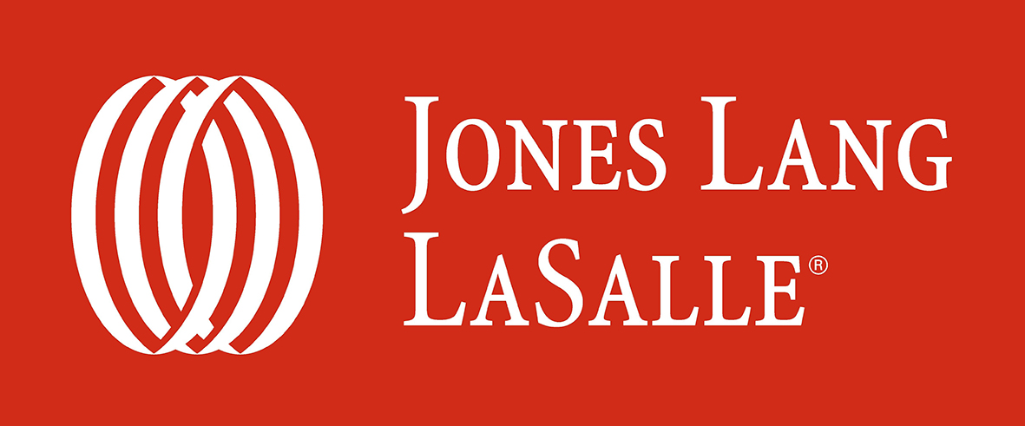


The Power Of Marketing
Domination of The Media
The fact that Bayleys is New Zealand’s largest full service agency gives us a huge advantage over our competitors in terms of leveraging the most value from key media outlets. We pride ourselves on the fact that we consistently dominate mass print and online media.
The New Zealand Herald 2012 Advertising Volumes
The Dominion Post YE March 2013 Advertising Volumes
Other

Slide 9
The Power of Marketing
Domination of The Digital Space
We currently utilise the widest range of digital marketing tools in the industry. In 2012 we were the number one commercial real estate agency in terms of online advertising with media giant APN.
Over the last 12 months we have advertised properties, tenancies and businesses across a wide range of highly effective online channels.
nzherald.co.nz
stuff.co.nz
trademe.co.nz
primecommercial.co.nz
facebook.co.nz
linkedin.co.nz
dompost.co.nz
thepress.co.nz
nbr.co.nz
interest.co.nz
primebusiness.co.nz
rightmove.co.nz
Bayleys
enquiry from digital
mediums has increased by a whopping
50%
4 years.
in the last

Slide 10
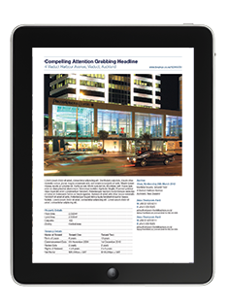
The Power Of Marketing
Our Award Winning Marketing Product Suite
We are proud to have pioneered a number of commercial property marketing methodologies that are now best practice in the market.
Innovation is at our forefront, today our mantra is – Bayleys’ don’t just print books! Our portfolio campaigns have evolved in to mutli-channelled, highly integrated products that expose our clients properties across a range of media including; print, online, tablet, mobile, search and social.
Regional Campaigns
Bayleys’ regional collections of commercial property for sale and lease.
Greater Auckland
Auckland Region
Greater Wellington
Wellington Region
Select
Waikato, Bay of
Plenty and Taranaki
Workspace
Hawkes Bay, Manawatu
Total Property
Bayleys’ national collection of commercial property and businesses for sale is released 5 times a year with each campaign containing an average of 95 commercial opportunities.
Leasing Focus
The Leasing Focus product suite provides landlords with a highly targeted vehicle to reach business decision makers based locally and offshore. The Leasing Focus model largely utilises digital media to reach business decision makers well in advance of them embarking on their relocation journeys.
Retail Leasing Focus
National
Office Leasing Focus
Auckland region
industrial Leasing Focus
Auckland region
North Shore Leasing Focus
The North region
Greater Wellington
Leasing Focus
Wellington region

Slide 11
Our Reach
National Reach
North of Auckland
Paul Jeeves
Commercial Manager
Real estate is a multi-disciplinary industry where different skills contribute to
the complete picture.
The team that leads our Commercial Division around the county brings together vast experience from the banking, management, valuation, finance, and marketing sectors, adding real weight to the transactional side of the business.
This expertise and business acumen is combined with Bayleys’ family based values at the highest levels of the company and sets the tone for how we approach business on a day-to-day basis.
Auckland’s North Shore
Daryl Devereux
Director
Nick Howe-Smith
Director
Auckland
John Church
General Manager
Chris Bayley
Manager, Manukau
Bay of Plenty,
Waikato & Taranaki
Richard Graham
Commercial Manager
Gisbourne
James MacPherson
Director
Hawke’s Bay, Manawatu, Wanganui & Wairarapa
Adrian van Dyk
Director
Nelson & Marlborough
Tony Vining
Commercial Manager
National
Mike Bayley
Managing Director
Bayley Corporation
David Bayley
Executive Director
Bayleys Real Estate
v
Wellington
Mark Hourigan
Director
Canterbury
Peter Whalan
Group Sales Manager
Dunedin
Robyn Hyndman
Director
Southern Lakes & Southland
David Grubb
Director

Slide 12
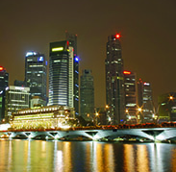

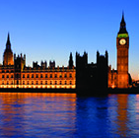

Our Reach
International Reach
Bayleys Global
We’re a proud New Zealand company. However, New Zealand’s comparatively small population means we only have a limited pool of domestic buyers. Consequently, Bayleys promotes commercial and industrial properties extensively overseas – opening up sizeable buyer networks.
David and Chris Bayley spearhead the company’s international property activities. Along with senior broker James Chan, David was instrumental in establishing Bayleys Asia. Our senior salespeople travel to the Australian, South East Asian, Middle Eastern, European, UK and US markets where New Zealand property is increasingly attractive
to purchasers. David and the team now offer more than 20 years offshore experience, and have managed more than NZ $4billion of transactions.

Slide 13
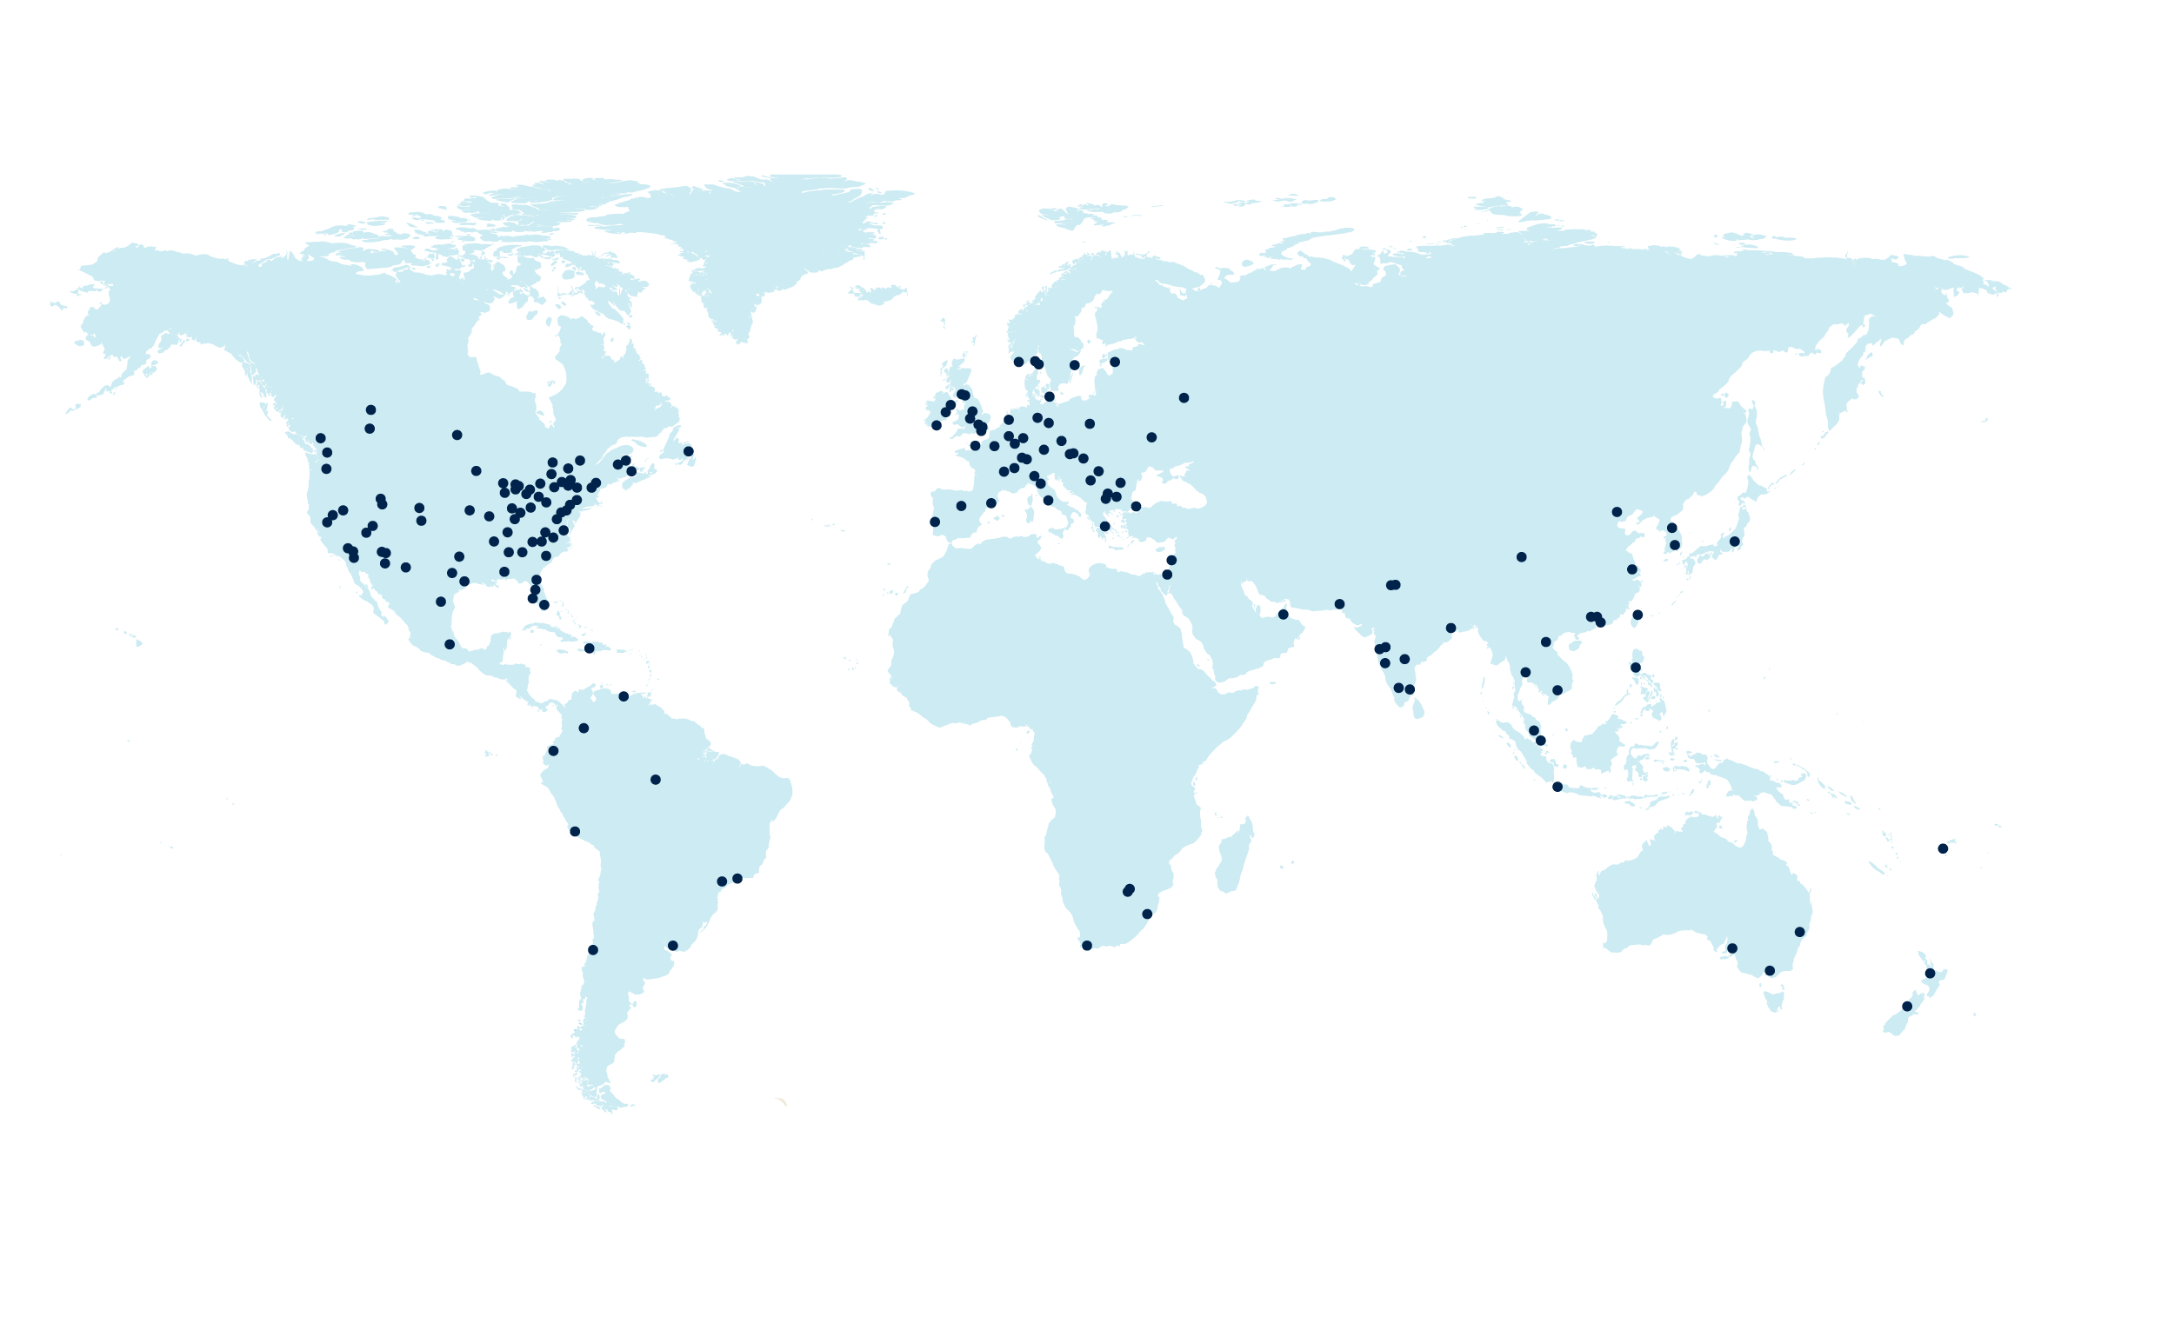
Our Reach
International Alliances
Cushman & Wakefield
Cushman & Wakefield is the world’s largest privately held commercial real estate services firm with over 250 offices in 60 countries. The company advises and represents clients on all aspects of property occupancy and investment, including leasing, sales and acquisitions; equity, debt and structured finance, corporate finance and investment banking; property, facilities and project management; corporate services, consulting and appraisal.
Cushman Wakefield partners with Bayleys to provide insight and expertise in the local market for its global clients. As a result major multi-nationals like Nokia, Revlon, and Omnicom use us to handle their property needs in New Zealand.
Going the other way, our close relationship with Cushman & Wakefield means that Bayleys clients looking for advice on overseas real estate markets have access to the expertise of the best global real estate network.
Christie’s International Real Estate
Christie’s International Real Estate is one of the world’s premium luxury brands in the sector and a global leader in high-end residential marketing and sales. With a network of 36,000 sales associates operating from 900 offices in more than 40 countries, Christie’s boasts annual sales topping $US128 billion.
Through Bayleys’ exclusive alliance with Christie’s we offer unique marketing options for exceptional properties by accessing high net-worth individuals otherwise unreachable from New Zealand shores.

